Slide 1
Lyndon B. Johnson
By: Danielle Ruff
Cartersville Elementary School
3rd Grade

Slide 2
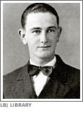
Early Life
Lyndon Baines Johnson was born in 1908 near Stonewall, Texas.
He was raised on a farm and worked very hard.
His family was poor and did not have electricity or indoor plumbing.

Slide 3
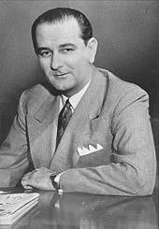
School
Johnson started school in a one-room schoolhouse when he was four.
He worked diligently in school and became a good public speaker.
After high school, Johnson went to college and became a teacher.

Slide 4
Teaching
Vocabulary
Lyndon’s first teaching job was in a very poor area of Texas.
The poverty of his students made a big impact on Johnson.
Johnson worked to end poverty in the United States later in his life.
Poverty: occurs when people do not have good living conditions or much money

Slide 5
Congressman
In the 1930s, Lyndon Johnson got involved in politics and was elected to Congress.
Johnson supported FDR’s New Deal while in Congress.
He made sure that Texas farmers received government help.
He became known for being a tolerant congressman who accepted other people’s viewpoints.

Slide 6
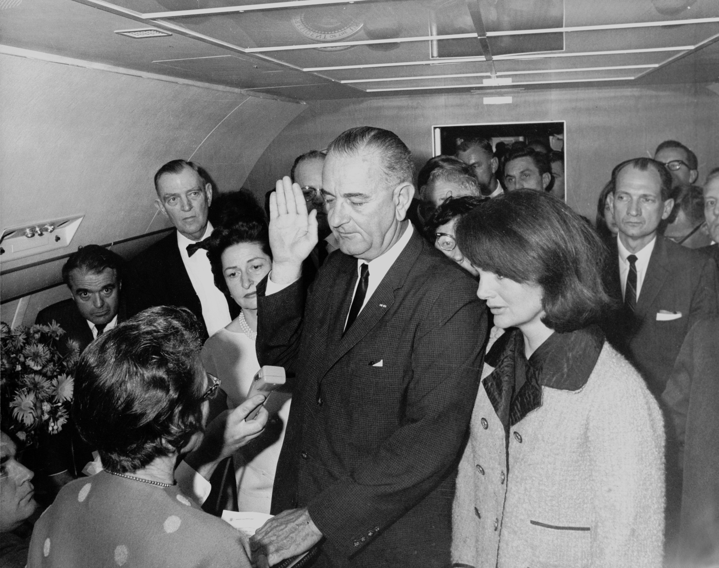
Vice President and Beyond
In 1960 when John F. Kennedy ran for President and asked Johnson to run as his Vice President.
Kennedy and Johnson won the election!
Three years later, on November 22, 1963, President John F. Kennedy was killed.
Johnson became President later that day.

Slide 7
Continuing Kennedy’s Work
Before JFK died, he had been working hard tp pass a civil rights bill.
Johnson pushed Congress to pass the civil rights bill into law.
The Civil Rights Act of 1964 protected the rights of African Americans and other minorities.
It made segregation in restaurants, theaters, and other public places illegal.
It also helped integrate schools.

Slide 8
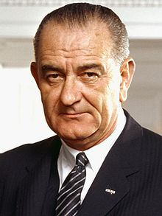
The Great Society
Johnson wanted to continue the changes that started with the New Deal.
In May 1964 Johnson gave a speech about his ideas.
He wanted to bring equality and new opportunities to all Americans.
He called his plan the Great Society.

Slide 9
The Great Society
The goal of the Great Society was to end poverty and racial injustice in the U.S.
He started programs that helped people find jobs and earn more money.
Poor families received help to buy food.
Schools received money to help them provide a better education for all.
Vocabulary
Injustice: when things are unfair

Slide 10
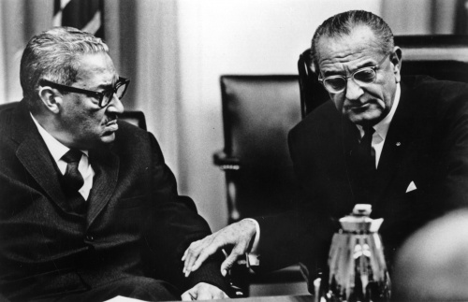
The Great Society
This plan also included new civil rights laws.
Johnson worked with Thurgood Marshall in get Congress to pass the Voting Rights Act of 1965 which would give minorities the right to vote.

Slide 11
End of Life
Lyndon Johnson died in 1973 at his ranch in Texas.
He is remembered as an important President who helped the poor and supported civil rights.

