Slide 1
Cesar Chavez
By: Danielle Ruff
Cartersville Elementary School
3rd Grade

Slide 2
Hard Times
Cesar Chavez was born in 1927 on a farm near Yuma Arizona.
His parents were from Mexico.
In 1937, during the Great Depression, the Chavez family lost their farm.
They started to earn a living as migrant workers.
Vocabulary
Migrant Workers: move from place to place in order to find work picking crops on farms.

Slide 3
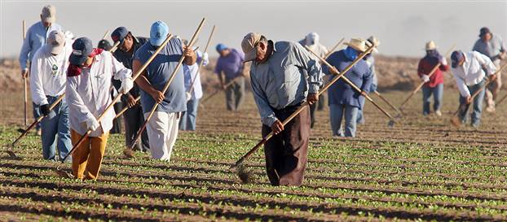
Hard Times
During the Great Depression, workers had few rights and many were treated unfairly.
The Chavez family worked long days and were paid very little money.
Many children in migrant working families did not go to school because their families needed them to work to make money.

Slide 4
Working for Change
When Cesar Chavez was older he wanted to help migrant workers.
He wanted them to have more rights and be treated fairly.
Chavez started by uniting migrant farm workers.
These groups of workers were called unions.
Chavez told the unions they could make big changes if they worked together.
Vocabulary
Uniting: bringing together

Slide 5
Working for Change
In 1962, Chavez started a union called the National Farm Workers Association (NFWA).
NFWA worked for better pay and treatment of farm workers.
The union made speeches and marched in protests.
They organized strikes also.
Vocabulary
Strike: is a protest when workers take action by refusing to work

Slide 6
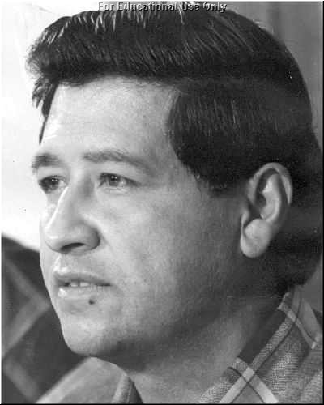
The Fight Goes On
After the grape boycott, Cesar Chavez and the NFWA did not stop their work.
In 1966 the NFWA formed a larger union, the United Farm Workers of America (NFW).
Over the next 27 years, Chavez led UFW strikes and protests to change labor laws.

Slide 7
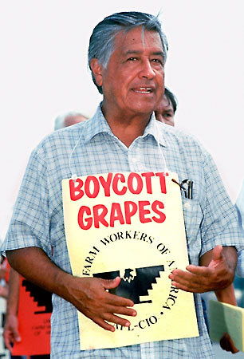
The Fight Goes On
Chavez traveled the country speaking to workers about their rights.
He also worked with the government to change unfair laws.
Chavez helped to make new laws that gave farm workers better pay, healthcare, and places to live.

Slide 8
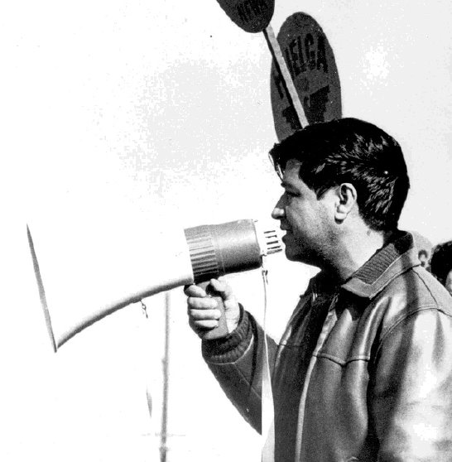
Helping People and the Environment
Chavez also worked to make farms and foods safer.
During the 1980s, many farms used harmful chemicals to kill pests.
Chavez led protests against the use of these chemicals.

Slide 9
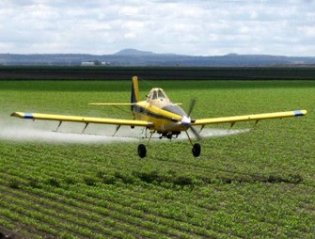
Helping People and the Environment
Eventually the U.S. government made laws to stop the use of some of these chemicals.
These laws helped protect people, animals, and the environment.

Slide 10
End of Life
Cesar Chavez died in 1993.
In 1994, President Bill Clinton awarded Chavez the Medal of Freedom for his work.
Cesar’s wife, Helen, and children accepted the medal for him.
Cesar Chavez spent his life fighting for a better life for other people.

