Slide 1
Thurgood Marshall
By: Danielle Ruff
Cartersville Elementary School
3rd Grade

Slide 2
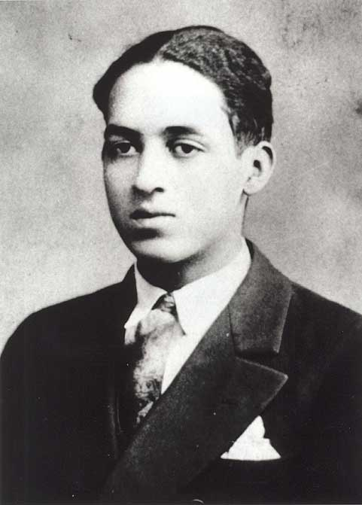
Early Life
Thurgood Marshall was born in 1908 in Baltimore, Maryland.
Education was important to Marshall’s parents.
He was smart, but liked to play pranks at school.
A principal once punished him by making him memorize the United States Constitution.

Slide 3
Because of the Punishment
Vocabulary
After memorizing the Constitution, Marshall realized that African Americans were not being treated fairly.
At this time in America segregation was still allowed.
Segregation: a policy of keeping people separated because of race or other differences
Example: Thurgood went to a school for African American children. There were no white children in his school.

Slide 4
The Fight For Justice Begins
Thurgood Marshall wanted to end segregation and give people of all races the same rights.
After college he decided to become a lawyer.
In 1930 he applied to a law school.
He was not let in because he was African American.
He did get into Howard University (a school for African Americans) in Washington, D.C.
He graduated first in his class in 1933.
He became a lawyer for the National Association for the Advancement of Colored People (NAACP).

Slide 5
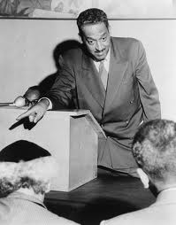
NAACP
The NAACP is a group that works to end discrimination in America.
The NAACP was founded on February 12, 1909.
The NAACP was formed partly in response to the Race Riot of 1908 in Springfield, Illinois.

Slide 6
Thurgood Marshall: Working for Civil Rights
By: Danielle Ruff
Cartersville Elementary School
3rd Grade

Slide 7
NAACP
Vocabulary
Marshall worked for the NAACP for the next 25 years.
He argued many court cases defending the civil rights of African Americans.
Marshall was a very good lawyer and won almost all of the cases he argued in front of the Supreme Court.
Civil Rights: the basic rights all citizens are supposed to have.

Slide 8
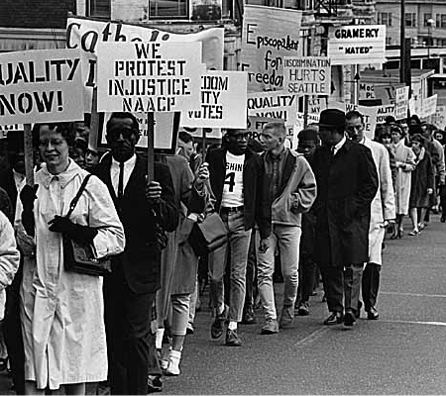
The Civil Rights Movement
Marshall’s legal work helped spark the Civil Rights Movement of the 1950s.
The civil rights movement began because people wanted to end discrimination and segregation.
Protests were held to persuade government leaders to change the unfair laws.

Slide 9
Famous Court Cases
Open your textbooks to pages 128-129.
Lets read about some of Thurgood Marshall’s most famous cases.

Slide 10
Thurgood Marshall: Later in Life
By: Danielle Ruff
Cartersville Elementary School
3rd Grade

Slide 11
Justice of the Supreme Court
In 1961 Marshall became a federal judge.
In 1965 he became the solicitor general
The solicitor general is the lawyer for the federal government.
Marshall was the first African American to serve in this position.
In 1967 President Lyndon B. Johnson appointed Marshall to the United States Supreme Court.

Slide 12
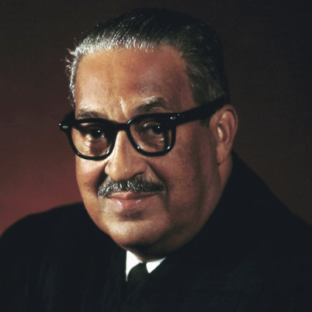
Supreme Court
Thurgood Marshall was the first African American to be a justice of the Supreme Court.
He served on the court for 24 years.
As a justice, he helped decide which laws followed the Constitution.
He also worked for equal rights under the law for all citizens.

Slide 13
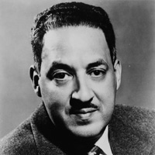
End of Life
Thurgood Marshall died in 1993.
Marshall is remember has an important man who fought for the civil rights of all Americans.
In 1993 the state of Maryland created a memorial for Marshall at the State House in Annapolis.

