Slide 1
Paul Revere
American Patriot

Slide 2
Purpose of Lesson
Standard: SS3H2 – The student will discuss the lives of Americans who expanded people’s rights and freedoms in a democracy.
Paul Revere (independence)
Explain social barriers, restrictions and barriers that these historical figures had to overcome and describe how they overcame them
Essential Question: How did Paul Revere help the United States become an independent country?

Slide 3
A Busy Man
As Paul Revere got older he became a very busy man. He had a large family of his own, so he had a lot of jobs to earn money.

Slide 4
Groups and Clubs
In the 1700’s many colonists joined clubs and groups to make friends and to talk. Paul Revere belonged to a group called the Sons of Liberty. The Sons of Liberty believed that the colonies should be free of British rule. People who thought this way were called Patriots later.

Slide 5
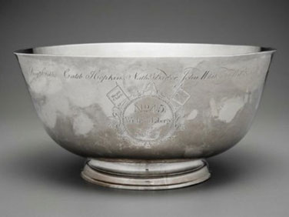
Paul Revere the Patriot
Paul Revere sometimes made silver objects from his silversmith shop to spread Patriot ideas. One of the most famous of these items was called the Liberty Bowl.
The Liberty Bowl celebrated a vote in Massachusetts that many colonists thought was unfair

Slide 6
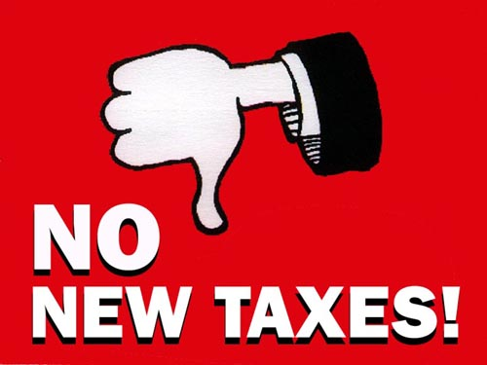
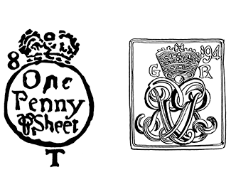
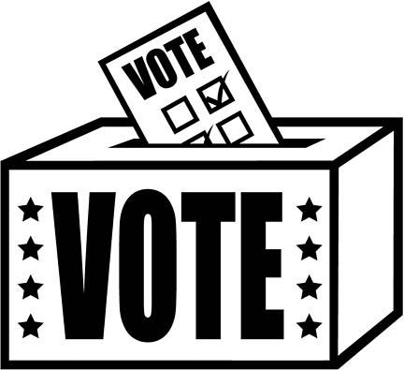
Taxes
In the 1760’s and 1770’s, the British government put taxes on goods sold in the colonies in order to raise money. Tax is money people pay to a government in return for services. Many colonists were angry about the taxes since they could not choose a person who would vote on them.

Slide 7
Boycott
The sons of Liberty told people to boycott British goods. A boycott is when you refuse to buy or use goods to prove a point. The Sons of Liberty hoped that if colonists refused to buy taxed goods the British government would cancel the taxes.

Slide 8
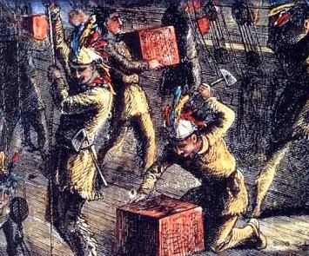
Boston Tea Party
In 1773 Paul Revere helped plan a protest against a tax on tea. A protest is an event at which people speak out about an issue.
In the middle of the night, colonists dressed up like Native Americans and climbed onto a ship carrying tea from Britain. They dumped the tea into the harbor.
This event became known as the Boston Tea Party.

Slide 9
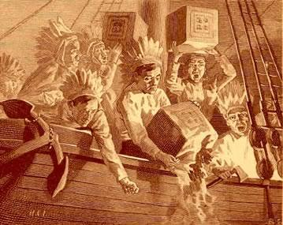
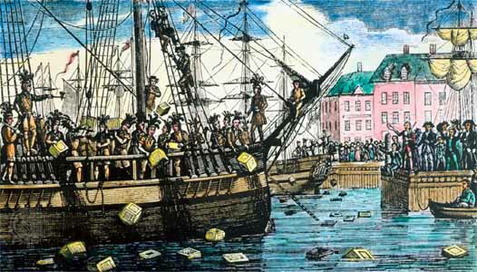
Boston Tea Party
When Patriots dressed up like Native Americans and dumped the tea into the Boston harbor to protest high taxes.

Slide 10
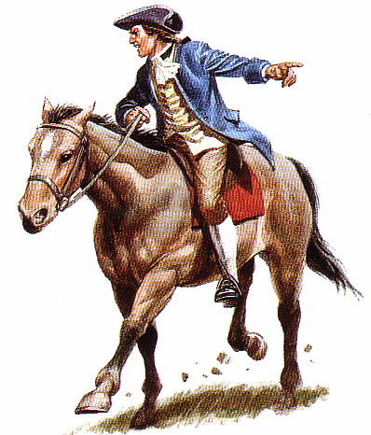
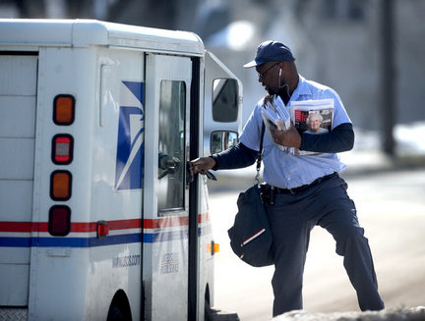
Mail Carrier
Soon after the Boston Tea Party Paul Revere began a new job. He carried mail for leaders of the Massachusetts colony. He rode a horse as fast as he could to bring news and important papers to leaders in other colonies.

Slide 11
What did you learn?
What is the Boston Tea Party?
When all of the people in Boston get dressed in fancy clothes and drink tea together
When tea goes on sale in Boston
When Patriots dressed like Native Americans and dumped tea into the Boston harbor to protest high taxes
2. What does the word liberty mean?
Freedom
Courage
Bravery
3. What was the name of one of the groups Paul Revere belonged to?
The silversmith alliance
The Red Coats
The Sons of Liberty

Slide 12
Vocabulary
Liberty
Money people pay to a government in return for services
Boycott
An event where people speak out about an issue
Protest
Freedom
Taxes
To refuse to use or buy a product to prove a point

Slide 13
Mrs. Carr 9-17-12
Vocabulary
Liberty - Freedom
Taxes – Money people pay to a government in return for services
Boycott – to refuse to buy or use a product to make a point
Protest – an event where people speak out about an issue

