Slide 1
Frederick Douglass
3rd Grade Social Studies

Slide 2
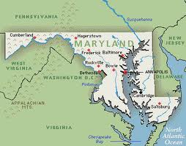
Born Into Slavery
Frederick Douglass was born a slave in Tuckahoe, Maryland in 1818.
He was a slave for the first 20 years of his life.

Slide 3
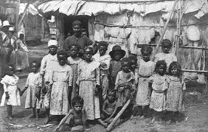
Slavery
Definition
A system where people are forced to work for no pay
To work very hard
A slave has no rights.
Slaves have to do what they are told.
Most slaves work on large farms called plantations.

Slide 4
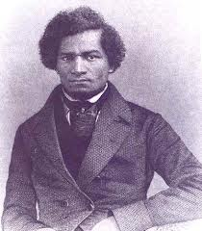
Dreaming of Freedom
Frederick was taken from his mother when he was just a baby.
He lived on a separate plantation with his grandmother.
He was sad and hungry most of the time.
He wanted to go to school and be FREE.

Slide 5
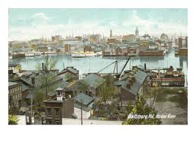
A New Opportunity
When Frederick was 8 he was sent to Baltimore to work for a family who owned a ship-building business
He was taught to read

Slide 6
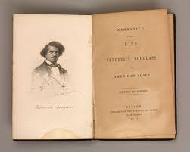
A New Opportunity
When Frederick was 15 he was sent to a farm in St. Michaels, Maryland where he was treated poorly again.
Frederick continued to dream of FREEDOM and finished teaching himself how to read and write.

Slide 7
Speaking Out Against Slavery
3rd Grade Social Studies

Slide 8
Different Parts of the country
Not all of the U.S. believed in slavery. Some of the Northern states were free states.
A free state was a state where slavery was not allowed.
Slavery was not needed in the North because the farms were smaller.
Many people in the north thought slavery was wrong.

Slide 9
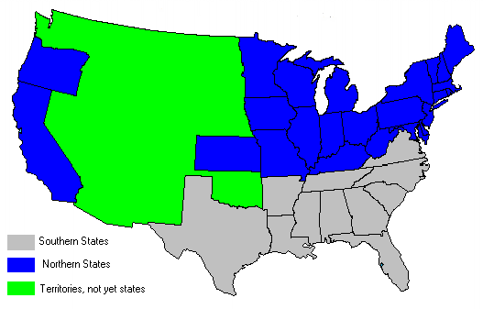
U.S. Map of Free and Slaved States

Slide 10
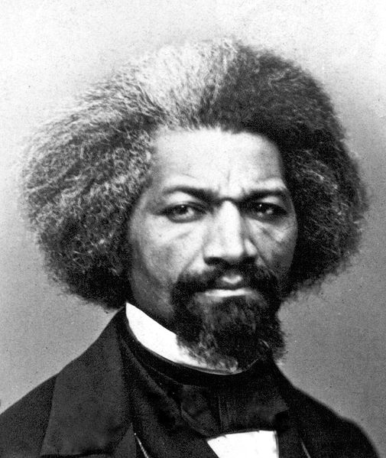
Escaping Slavery
If a slave could escape slavery they would go to the Northern states to be free.
Frederick Douglass finally knew what he had to do.
He had to escape slavery and go North!

Slide 11
A Daring Escape
On September 3, 1838 Frederick Douglass escaped slavery.
He got on a train dressed as a sailor.
When the conductor asked to see his papers that proved that he was a free man Frederick handed him papers he had borrowed from an actual sailor.
Frederick was on his way to New Bedford, Massachusetts.

Slide 12
The Anti-Slavery Movement
When Frederick made it to Massachusetts he met other people who thought slavery was wrong.
These people gave speeches and wrote papers about the poor treatment enslaved people endured and helped some slaves escape.
Frederick joined this movement and began to give speeches also.

Slide 13
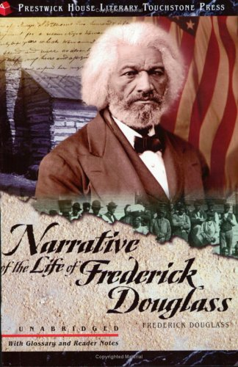
Writing a Book
In 1845, Frederick Douglass wrote a book about his life.
It was titled Narrative of the Life of Frederick Douglass.

Slide 14
Other Parts of His Life
Frederick moved to Ireland for a while and lived in Great Britain to escape the reach of his old master.
He eventually moved back to the U.S. and began to publish a newspaper that urged people to help end slavery.
Frederick married Anna and had five children. He lived in Washington D.C. for a time as well.

